Slide 1

A national science & engineering cloud
funded by the National Science Foundation
Award #ACI-1445604

Slide 2
What is Jetstream?
NSF’s first cloud dedicates top support for science and engineering research across all areas of activity supported by the NSF
Jetstream will be a user-friendly cloud environment designed to give researchers and research students access to interactive computing and data analysis resources “on demand.”
It will provide a library of virtual machines that users can select from to do their research.
Software creators and researchers will also be able to create their own customized virtual machines -or- their own “private computing system” within Jetstream.
It will enable countless discoveries across disciplines such as biology, atmospheric science, economics, network science, observational astronomy, and social sciences.
Two important biology platforms will be supported - iPlant and Galaxy.

Slide 3
What does the name mean? And is it really a cloud?
Name
In the atmosphere, the Jetstream lies at the border of two different air masses.
The Jetstream system stands at the border of the existing NSF-funded XD program and advanced cyberinfrastructure resources and users who have not previously used such NSF-funded infrastructure before.
Yes, it’s really a cloud. Software layers:
Atmosphere interface
KVM
OpenStack
CentOS Linux

Slide 4
Science Domains and Users
Biology
Earth Science/Polar Science
Field Station Research
Geographical Information Systems
Network Science
Observational Astronomy
Social Sciences
Jetstream will be particularly focused on researchers working in the “long tail” of science with born digital data.
Enabling analysis of field-collected empirical data on the impact and effects of global climate change will be one of the specific foci of Jetstream
Whatever you do

Slide 5
21st century workforce development
Jetstream will include virtual Linux desktops and applications specifically aimed at enabling research and research education at small colleges and universities including HBCUs (Historically Black Colleges and Universities), MSIs (Minority Serving Institutions), Tribal colleges, and higher-ed institutions in EPSCoR States.
Jetstream will also support deployment of user-friendly Science Gateways.

Slide 6
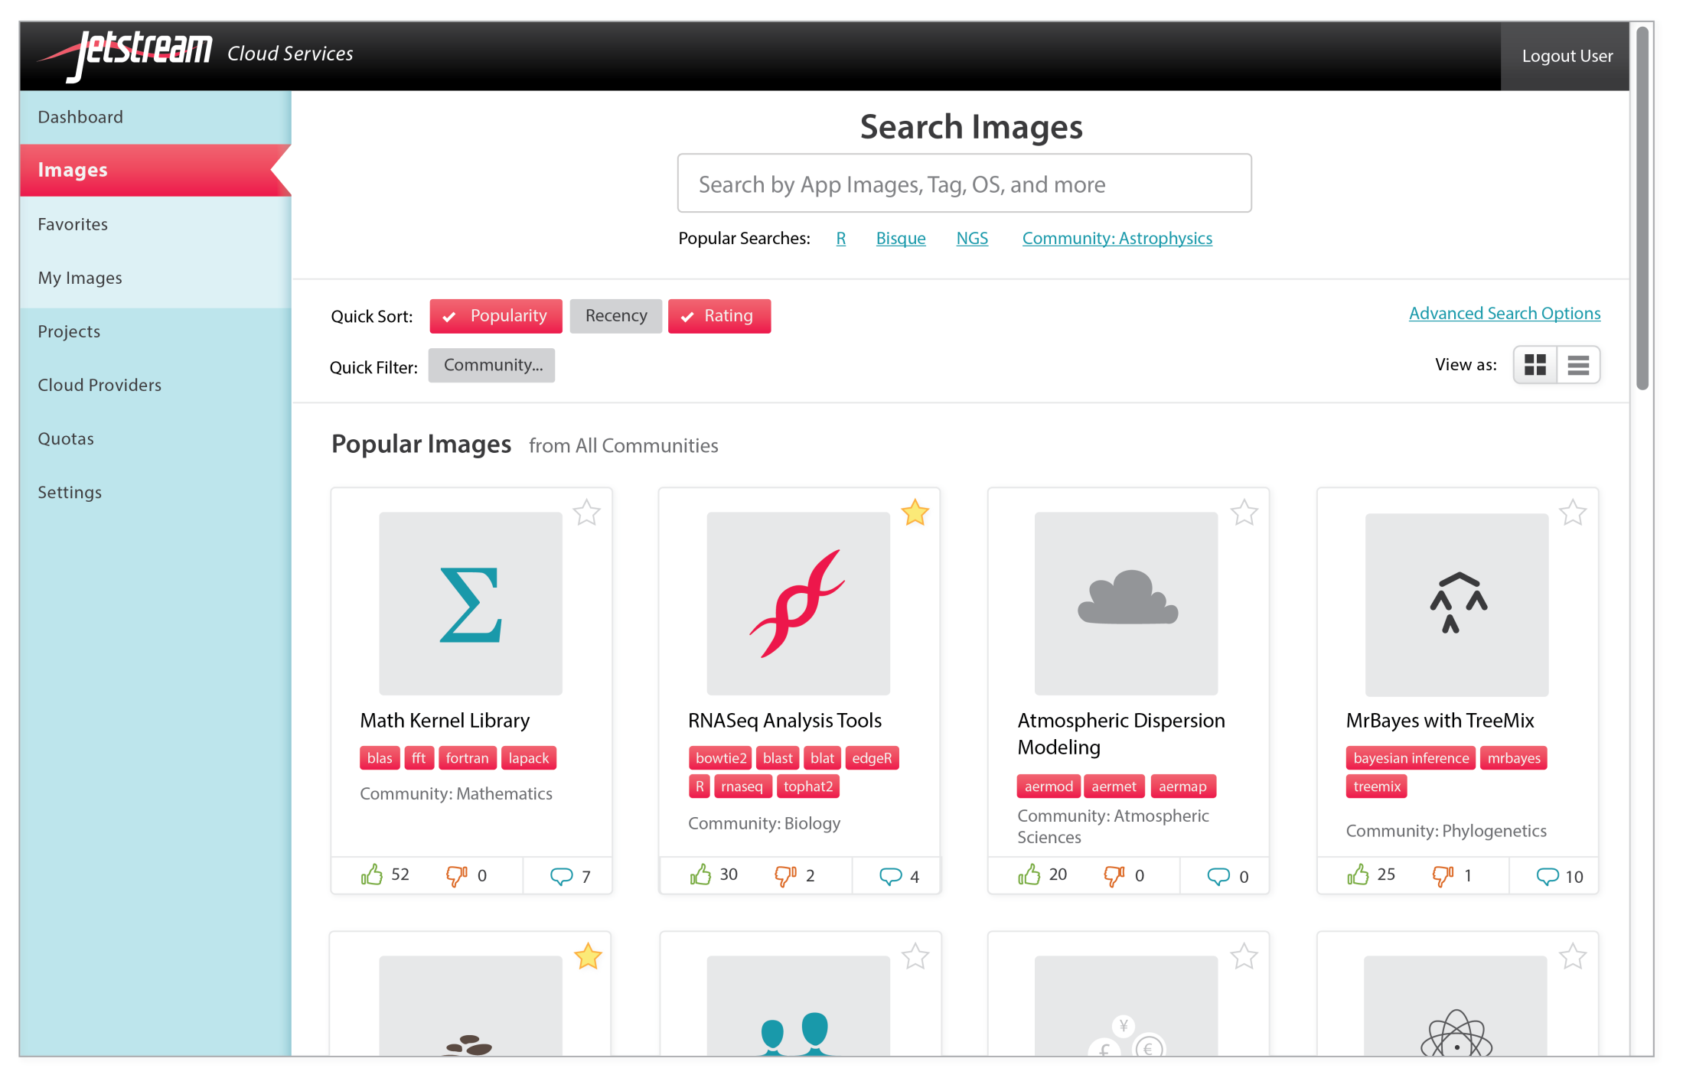

Slide 7
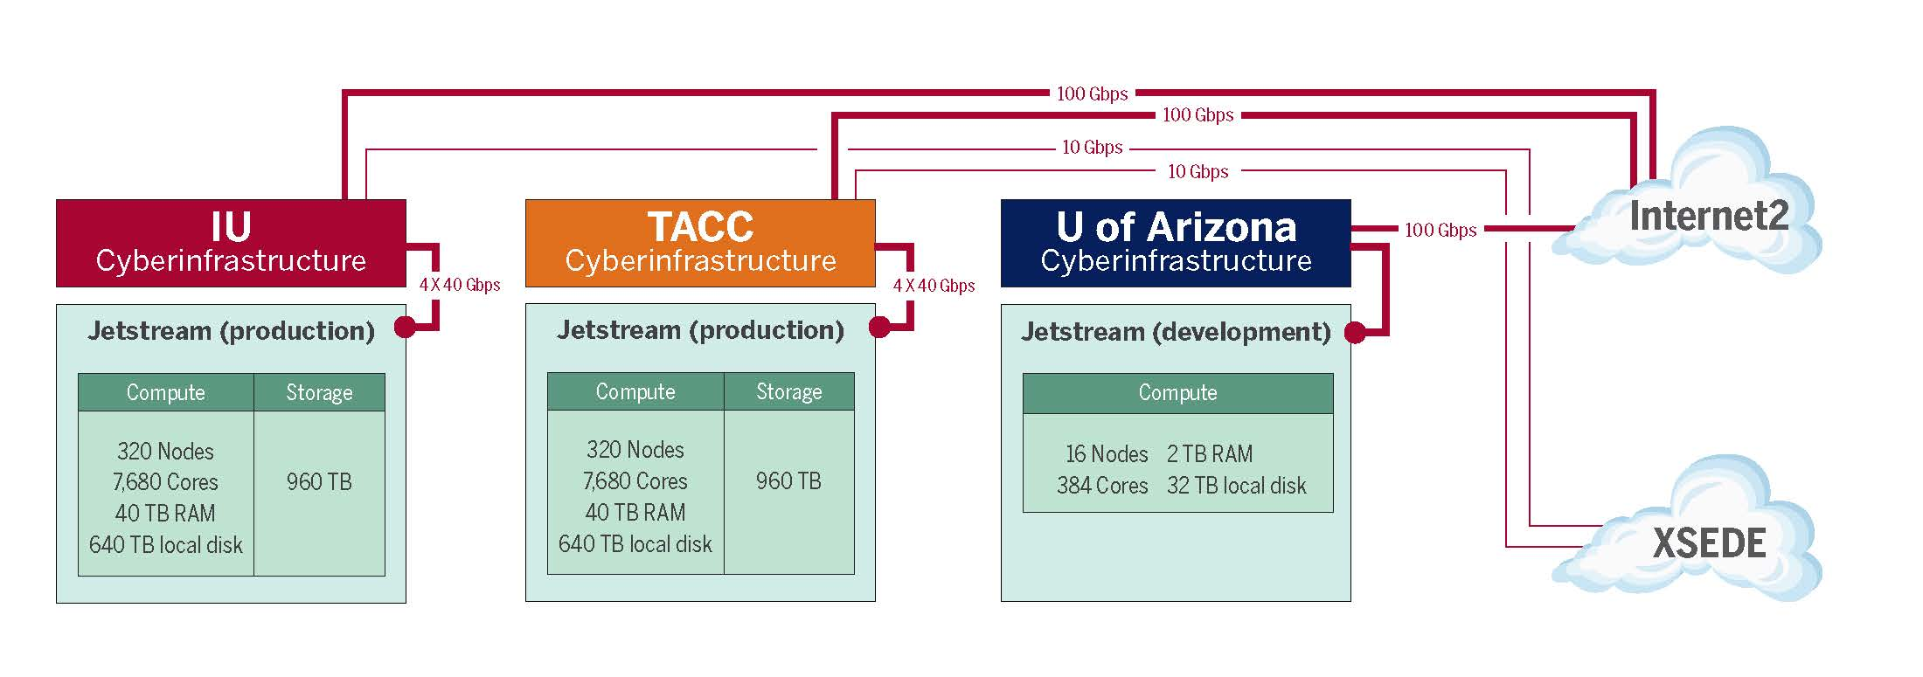
Jetstream System Diagram

Slide 8
Jetstream Hardware Components
 | Jetstream Site | #CPUs | # Physical Cores | PFLOPS | Total RAM (GB) | Node Local Storage (TB) | Secondary Storage (TB) | Connection to Internet2 (Gbps)
Production Systems | IU | 640 | 7,680 | 0.258 | 40,960 | 640 | 960 | 100
 | TACC | 640 | 7,680 | 0.258 | 40,960 | 640 | 960 | 100
Test & Development System | Arizona | 32 | 384 | 0.013 | 2,048 | 32 | 192 | 100
 | Total | 1,312 | 15,744 | 0.529 | 83,968 | 1,312 | 2,112 | 300

Slide 9
News for software developers
Jetstream is enabling cyberinfrastructure
RESTful APIs
You build, package, deploy
Users run on NSF-funded hardware
Can leverage Globus technology for data movement and authentication

Slide 10
Jetstream Deployment Partner Organizations
A seasoned team of organizations and experts:
University of Texas Austin (TACC)
University of Chicago (Argonne National Lab)
University of Arizona
University of Texas at San Antonio (Open Cloud Lab)
Johns Hopkins University
Penn State University

Slide 11
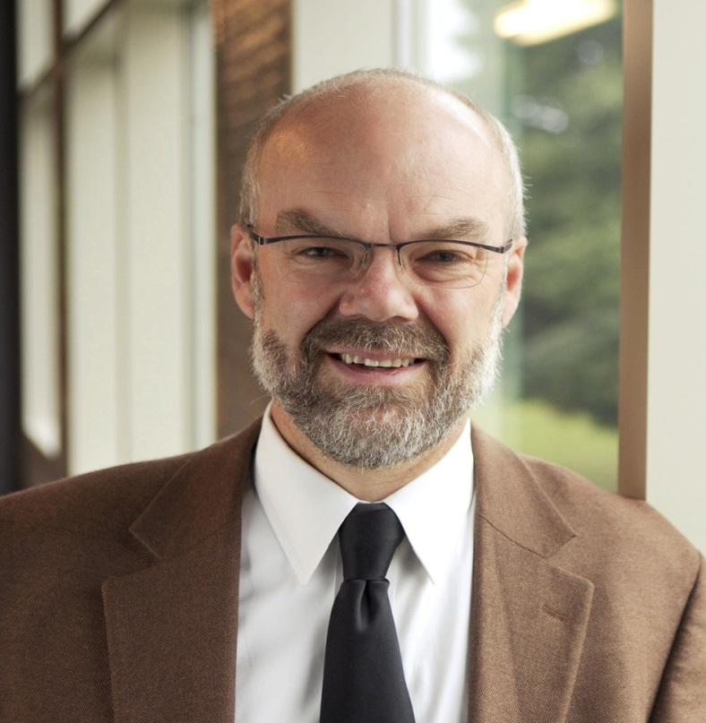
Indiana University – Lead
Dr. Craig Stewart, Principal Investigator
Site for Dell production hardware
Primary data storage facility
IU School of Informatics & Computing faculty participants:
Dr. Beth Plale – Hathi Trust Research Center applications; Big Data
Dr. Katy Börner – Network science applications
Dr. Volker Brendel – Bioinformatics, computational science education
IUPUI Computer & Information Science faculty participants:
Dr. Fengguang Song – CPU- and node-level performance

Slide 12
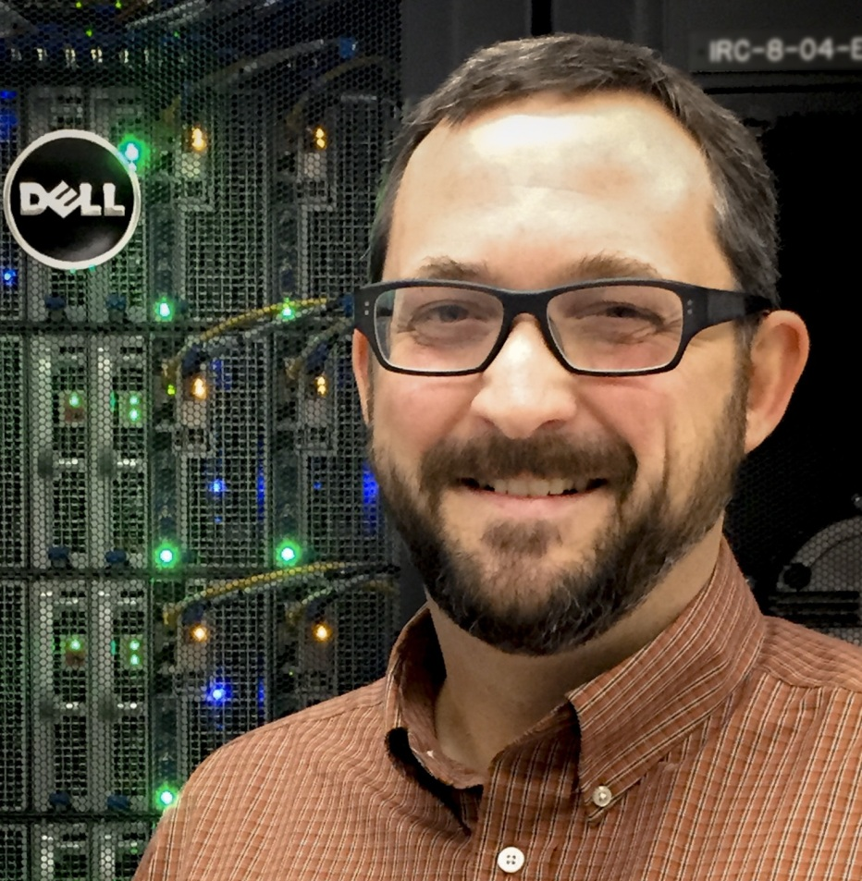
University of Texas Austin – Texas Advanced Computing Center
Dr. Matthew Vaughn, Co-Principal Investigator
Site for Dell production hardware
Primary data storage facility

Slide 13
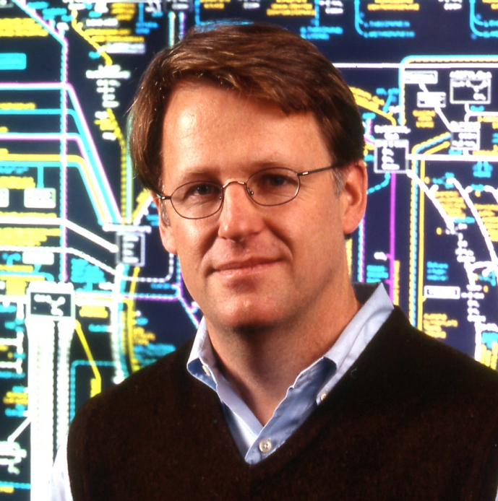
University of Chicago – Computation Institute
Dr. Ian Foster, Co-Principal Investigator
Integrate Globus services into Jetstream

Slide 14
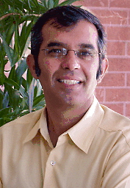
University of Arizona
Dr. Nirav Merchant, Co-Principal Investigator
Dell hardware test/development site
Lead Atmosphere implementation
Bryan Heidorn participating in VMs related to field research stations

Slide 15
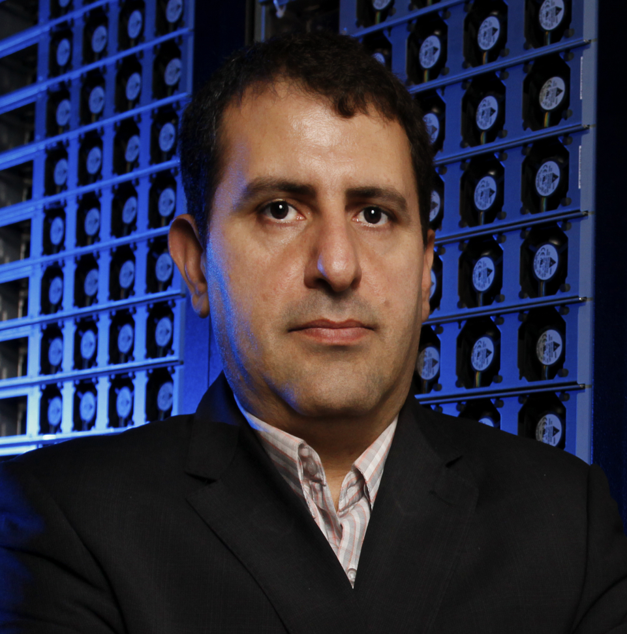
The University of Texas at San Antonio
Dr. Paul Rad, Open Cloud Lab
OpenStack software integration for cloud environment

Slide 16
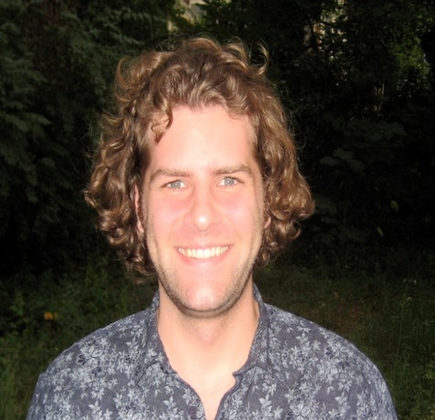
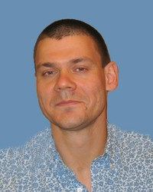
Johns Hopkins University & Penn State University
Dr. James Taylor, Co-Principal Investigator (JHU)
Dr. Anton Nekrutenko, PSU
Lead implementation of Galaxy software

Slide 17
Jetstream Application & Outreach Collaborators
Cornell University –Ms. Susan Mehringer, Lead. Cornell® Virtual Workshops about Jetstream and applications running on Jetstream.
University of Arkansas at Pine Bluff – Dr. Jesse Walker, lead. Cybersecurity education, Minority Serving Education outreach
University of Hawaii – Dr. Gwen Jacobs, lead. EPSCoR early adopter/user. Jacobs will chair Science Advisory Board
National Snow and Ice Data Center (NSIDC) – Dr. Ron Weaver, lead. Data retrieval from NSIDC, application integration with ice sheet analysis applications
University of North Carolina, Odum Center –Dr. Thomas Carsey , lead. Data retrieval from Dataverse Network
National Center for Genome Analysis at Indiana University – providing genome analysis software. Includes TACC, PSC, and SDSC as partners

Slide 18
Questions?
Questions can be e-mailed to pti@iu.edu
Visit the project website - pti.iu.edu/jetstream

